Slide 1

Fundamentals of Database Systems
Seventh Edition
Chapter 22
Database Recovery Techniques
Copyright © 2016, 2011, 2007 Pearson Education, Inc. All Rights Reserved
Notes:
If this PowerPoint presentation contains mathematical equations, you may need to check that your computer has the following installed:
1) MathType Plugin
2) Math Player (free versions available)
3) NVDA Reader (free versions available)

Slide 2
Introduction
Recovery algorithms
Recovery concepts
Write-ahead logging
In-place versus shadow updates
Rollback
Deferred update
Immediate update
Certain recovery techniques best used with specific concurrency control methods

Slide 3
22.1 Recovery Concepts (1 of 9)
Recovery process restores database to most recent consistent state before time of failure
Information kept in system log
Typical recovery strategies
Restore backed-up copy of database
Best in cases of extensive damage
Identify any changes that may cause inconsistency
Best in cases of noncatastrophic failure
Some operations may require redo

Slide 4
Recovery Concepts (2 of 9)
Deferred update techniques
Do not physically update the database until after transaction commits
Undo is not needed; redo may be needed
Immediate update techniques
Database may be updated by some operations of a transaction before it reaches commit point
Operations also recorded in log
Recovery still possible

Slide 5
Recovery Concepts (3 of 9)
Undo and redo operations required to be idempotent
Executing operations multiple times equivalent to executing just once
Entire recovery process should be idempotent
Caching (buffering) of disk blocks
D B M S cache: a collection of in-memory buffers
Cache directory keeps track of which database items are in the buffers

Slide 6
Recovery Concepts (4 of 9)
Cache buffers replaced (flushed) to make space for new items
Dirty bit associated with each buffer in the cache
Indicates whether the buffer has been modified
Contents written back to disk before flush if dirty bit equals one
Pin-unpin bit
Page is pinned if it cannot be written back to disk yet

Slide 7
Recovery Concepts (5 of 9)
Main strategies
In-place updating
Writes the buffer to the same original disk location
Overwrites old values of any changed data items
Shadowing
Writes an updated buffer at a different disk location, to maintain multiple versions of data items
Not typically used in practice
Before-image: old value of data item
After-image: new value of data item

Slide 8
Recovery Concepts (6 of 9)
Write-ahead logging
Ensure the before-image (B F I M) is recorded
Appropriate log entry flushed to disk
Necessary for UNDO operation if needed
UNDO-type log entries
REDO-type log entries

Slide 9
Recovery Concepts (7 of 9)
Steal/no-steal and force/no-force
Specify rules that govern when a page from the database cache can be written to disk
No-steal approach
Cache buffer page updated by a transaction cannot be written to disk before the transaction commits
Steal approach
Recovery protocol allows writing an updated buffer before the transaction commits

Slide 10
Recovery Concepts (8 of 9)
Force approach
All pages updated by a transaction are immediately written to disk before the transaction commits
Otherwise, no-force
Typical database systems employ a steal/no-force strategy
Avoids need for very large buffer space
Reduces disk I/O operations for heavily updated pages

Slide 11
Recovery Concepts (9 of 9)
Write-ahead logging protocol for recovery algorithm requiring both UNDO and REDO
B F I M of an item cannot be overwritten by its after image until all UNDO-type log entries have been force-written to disk
Commit operation of a transaction cannot be completed until all REDO-type and UNDO-type log records for that transaction have been force-written to disk

Slide 12
Checkpoints in the System Log and Fuzzy Checkpointing (1 of 2)
Taking a checkpoint
Suspend execution of all transactions temporarily
Force-write all main memory buffers that have been modified to disk
Write a checkpoint record to the log, and force-write the log to the disk
Resume executing transactions
D B M S recovery manager decides on checkpoint interval

Slide 13
Checkpoints in the System Log and Fuzzy Checkpointing (2 of 2)
Fuzzy checkpointing
System can resume transaction processing after a begin_checkpoint record is written to the log
Previous checkpoint record maintained until end_checkpoint record is written

Slide 14
Transaction Rollback
Transaction failure after update but before commit
Necessary to roll back the transaction
Old data values restored using undo-type log entries
Cascading rollback
If transaction T is rolled back, any transaction S that has read value of item written by T must also be rolled back
Almost all recovery mechanisms designed to avoid this

Slide 15
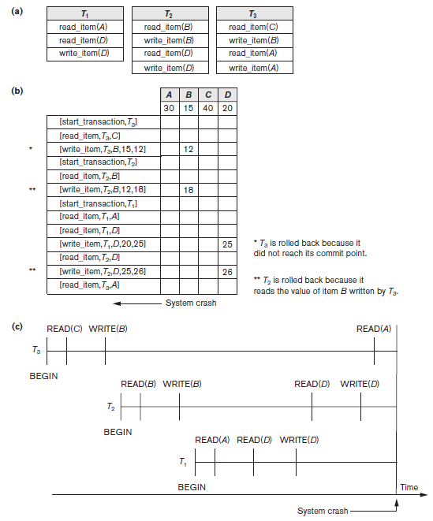
Figure 22.1 Illustrating Cascading Rollback (A Process That Never Occurs in Strict or Cascadeless Schedules)
(a) The read and write operations of three transactions (b) System log at point of crash (c) Operations before the crash

Slide 16
Transactions That Do Not Affect the Database
Example actions: generating and printing messages and reports
If transaction fails before completion, may not want user to get these reports
Reports should be generated only after transaction reaches commit point
Commands that generate reports issued as batch jobs executed only after transaction reaches commit point
Batch jobs canceled if transaction fails

Slide 17
22.2 NO-UNDO/REDO Recovery Based on Deferred Update (1 of 3)
Deferred update concept
Postpone updates to the database on disk until the transaction completes successfully and reaches its commit point
Redo-type log entries are needed
Undo-type log entries not necessary
Can only be used for short transactions and transactions that change few items
Buffer space an issue with longer transactions

Slide 18
NO-UNDO/REDO Recovery Based on Deferred Update (2 of 3)
Deferred update protocol
Transaction cannot change the database on disk until it reaches its commit point
All buffers changed by the transaction must be pinned until the transaction commits (no-steal policy)
Transaction does not reach its commit point until all its REDO-type log entries are recorded in log and log buffer is force-written to disk

Slide 19
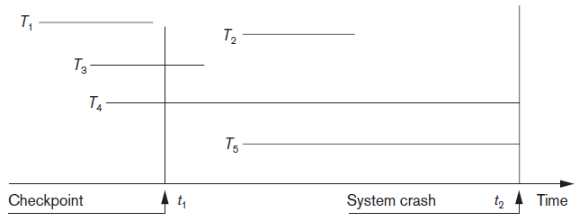
NO-UNDO/REDO Recovery Based on Deferred Update (3 of 3)
Figure 22.2 An example of a recovery timeline to illustrate the effect of checkpointing

Slide 20
22.3 Recovery Techniques Based on Immediate Update
Database can be updated immediately
No need to wait for transaction to reach commit point
Not a requirement that every update be immediate
UNDO-type log entries must be stored
Recovery algorithms
UNDO/NO-REDO (steal/force strategy)
UNDO/REDO (steal/no-force strategy)

Slide 21
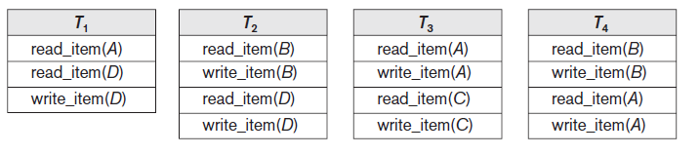
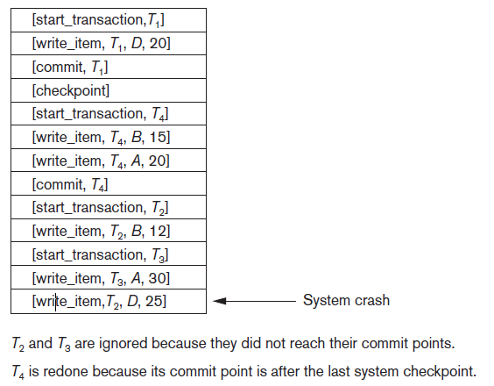
Figure 22.3 An Example of Recovery Using Deferred Update with Concurrent Transactions
(a) The READ and WRITE operations of four transactions (b) System log at the point of crash

Slide 22
22.4 Shadow Paging (1 of 3)
No log required in a single-user environment
Log may be needed in a multiuser environment for the concurrency control method
Shadow paging considers disk to be made of n fixed-size disk pages
Directory with n entries is constructed
When transaction begins executing, directory copied into shadow directory to save while current directory is being used
Shadow directory is never modified

Slide 23
Shadow Paging (2 of 3)
New copy of the modified page created and stored elsewhere
Current directory modified to point to new disk block
Shadow directory still points to old disk block
Failure recovery
Discard current directory
Free modified database pages
NO-UNDO/NO-REDO technique

Slide 24
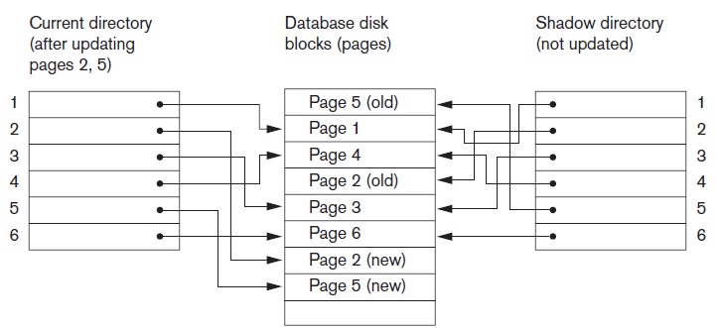
Shadow Paging (3 of 3)
Figure 22.4 An example of shadow paging
⁵The directory is similar to the page table maintained by the operating system for each process.

Slide 25
22.5 The ARIES Recovery Algorithm (1 of 3)
Used in many I B M relational database products
Uses a steal/no-force approach for writing
Concepts
Write-ahead logging
Repeating history during redo
Retrace all database system actions prior to crash to reconstruct database state when crash occurred
Logging changes during undo
Prevents ARIES from repeating completed undo operations if failure occurs during recovery

Slide 26
The ARIES Recovery Algorithm (2 of 3)
Analysis step
Identifies dirty (updated) pages in the buffer and set of transactions active at the time of crash
Determines appropriate start point in the log for the REDO operation
REDO
Reapplies updates from the log to the database
Only necessary REDO operations are applied

Slide 27
The ARIES Recovery Algorithm (3 of 3)
UNDO
Log is scanned backward
Operations of transactions that were active at the time of the crash are undone in reverse order
Every log record has associated log sequence number (L S N)
Indicates address of log record on disk
Corresponds to a specific change of some transaction

Slide 28
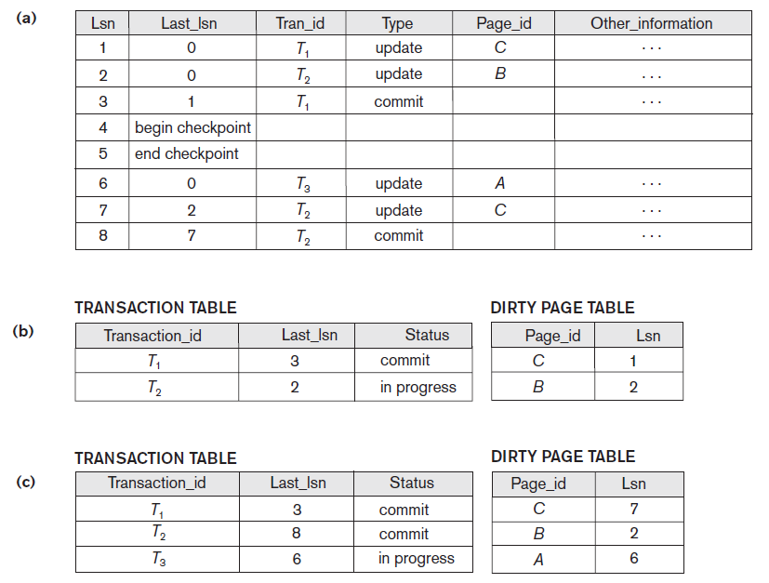
ARIES Recovery Example
Figure 22.5 An example of recovery in ARIES (a) The log at point of crash (b) The Transaction and Dirty Page Tables at time of checkpoint (c) The Transaction and Dirty Page Tables after the analysis phase

Slide 29
22.6 Recovery in Multidatabase Systems (1 of 2)
Two-level recovery mechanism
Global recovery manager (coordinator) needed to maintain recovery information
Coordinator follows two-phase commit protocol
Phase 1: Prepare for commit message
Ready to commit or cannot commit signal returned
Phase 2: Issue commit signal
Either all participating databases commit the effect of the transaction or none of them do

Slide 30
Recovery in Multidatabase Systems (2 of 2)
Always possible to recover to a state where either the transaction is committed or it is rolled back
Failure during phase 1 requires rollback
Failure during phase 2 means successful transaction can recover and commit

Slide 31
22.7 Database Backup and Recovery from Catastrophic Failures (1 of 2)
Database backup
Entire database and log periodically copied onto inexpensive storage medium
Latest backup copy can be reloaded from disk in case of catastrophic failure
Backups often moved to physically separate locations
Subterranean storage vaults

Slide 32
Database Backup and Recovery from Catastrophic Failures (2 of 2)
Backup system log at more frequent intervals and copy to magnetic tape
System log smaller than database
Can be backed up more frequently
Benefit: users do not lose all transactions since last database backup

Slide 33
22.8 Summary
Main goal of recovery
Ensure atomicity property of a transaction
Caching
In-place updating versus shadowing
Before and after images of data items
UNDO and REDO operations
Deferred versus immediate update
Shadow paging
Catastrophic failure recovery

Slide 34

Copyright

